Slide 1
Employee Data Analysis using Excel
STUDENT NAME: RITHIKA.S
REGISTER NO: 312209784
DEPARTMENT: B.COM COMPUTER APPLICATIONS
NAAN MUDALVAN ID: asunm1353312209784
COLLEGE: ANNA ADARSH COLLEGE

Slide 2
PROJECT TITLE
Employee Performance Analysis using Excel

Slide 3


AGENDA
Problem Statement
Project Overview
End Users
Our Solution and Proposition
Dataset Description
Modelling Approach
Results and Discussion
Conclusion
3/21/2024 Annual Review

Slide 4

PROBLEM STATEMENT
Improving Employee Experience
Informed Decision-Making
Identifying Trends and Patterns
Ensuring Fairness and Compliance
Strategic Planning
Enhancing productivity
Employee attendance
Improve employee performance

Slide 5
PROBLEM STATEMENT :
Analyzing employee performance is important for a company because it helps:
1.Identify high, average, and low performers:
Performance appraisals help managers identify how each employee is performing and can help them support employees who need guidance.
2.Improve performance:
Performance appraisals can help an organization increase productivity and achieve its business goals.
3.Clarify expectations:
Performance appraisals can help employees understand what their manager expects of them and what their daily responsibilities are.
4.Determine training needs:
Performance appraisals can help determine what training an employee needs to advance in their field.
5.Decide on pay raises and promotions:
Performance appraisals can help determine pay raises, promotions, and other perks.
6.Help employees understand their career path
7.Performance appraisals can help employees understand where their career is going.
Help the company determine if an employee is productive or a liability

Slide 6

PROJECT OVERVIEW :
OBJECTIVE :
The objective of analyzing employee data and performing Employee Performance Analysis using Excel is to identify key performance metrics and track trends to understand employee performance.
This analysis supports data-driven decision-making, enhances employee development by tailoring growth programs, optimizes resource allocation, and ultimately contributes to improving overall organizational efficiency. Excel helps in effectively manipulating, visualizing, and interpreting the data to achieve these goals.
The Employee Records Dataset is a simulated dataset created to explore various data analysis and machine learning techniques in the context of human resources and employee management. This dataset mirrors the structure and characteristics of real employee data.

Slide 7

WHO ARE THE END USERS?
End users are basically those people whose jobs require access to the database for querying, updating, and generating reports.
Here are some of the key end users:
➢ Human resource department
➢ Managers and team leaders
➢ Executives and senior management
➢ Employees and Employers
➢ Training and development teams
➢ Data analysts

Slide 8
Who Are The End Users ?
Employee data performance analysis benefits several stakeholders within an organization:
Management and Leadership:
Provides insights for making informed decisions about promotions, compensation, and development needs.
HR Department:
Helps in designing targeted training programs, improving recruitment strategies, and managing employee relations more effectively.
Employees:
Offers feedback on their performance, highlights strengths and areas for improvement, and supports personal and professional growth.
Teams and Departments:
Identifies high performers and areas needing support, fostering better team dynamics and resource allocation.
Overall Organization:
Enhances organizational efficiency by optimizing workforce performance, aligning employee efforts with strategic goals, and improving productivity.

Slide 9
OUR SOLUTIONS AND VALUE PROPOSITION
USING CONDITIONAL FORMATTING :
By using conditional formatting we need find the missing values and fill the blank space with red color
USING FILTER :
By using filter option we need to filter the data and remove the blank spaces by giving “no fill” option
USING FORMULA :
By using the IFS formula we need to find the employee performance with the employee rating.
USING PIVOT TABLE :
By using pivot table we need to summarize the data.
USING GRAPH :
Finally we can insert a chart a bar chart or a pie diagram and represent the data graphically.

Slide 10
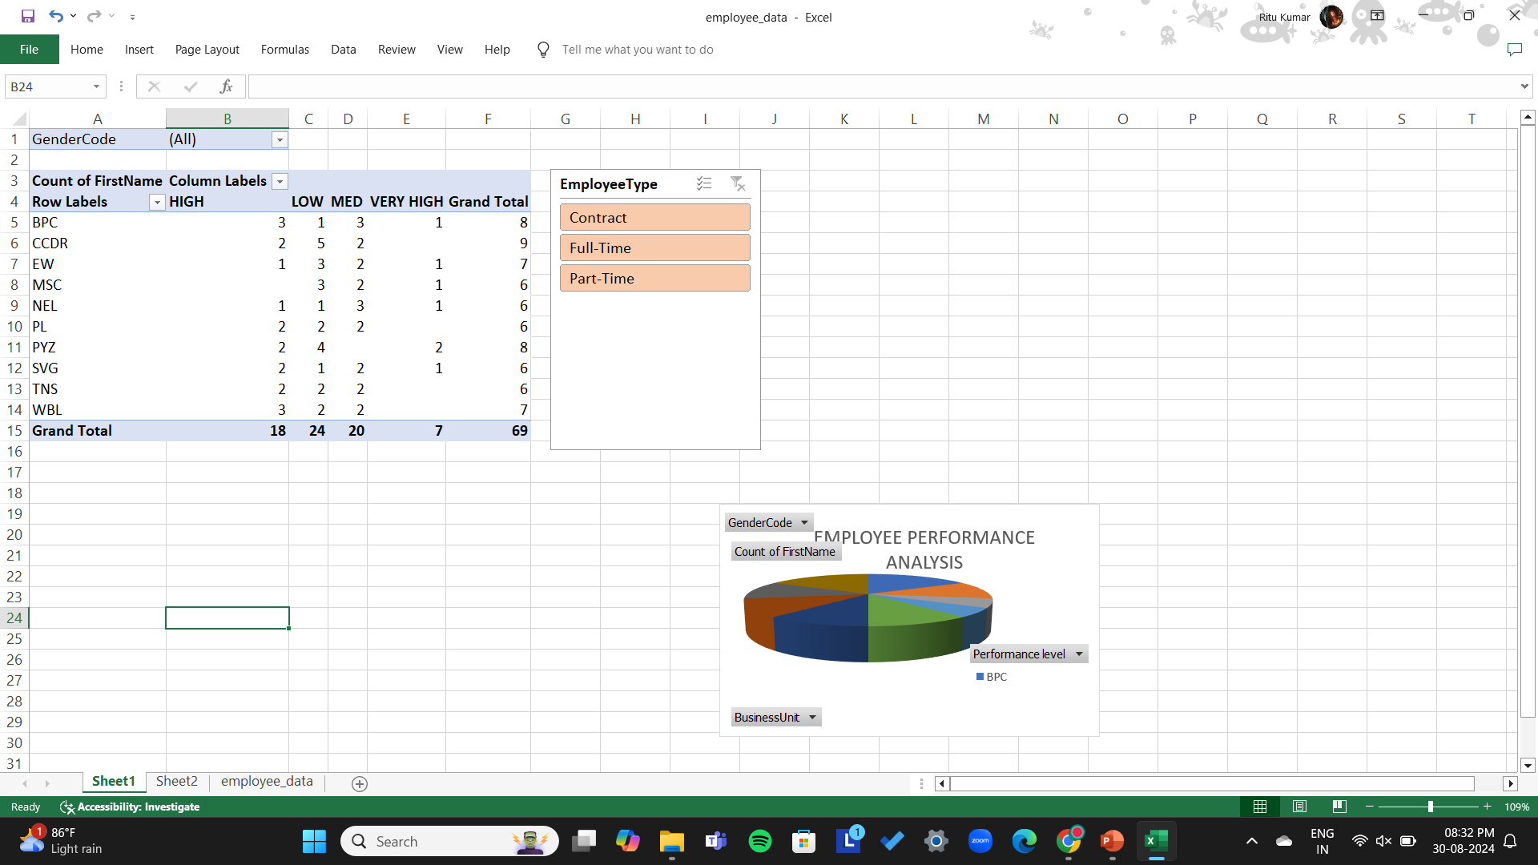
PIVOT TABLE :
Identify patterns and trends:
A PivotTable can help you see patterns, trends, and comparisons in your data.
Display statistics :
A PivotTable can display statistics as values or percentages, such as total turnover, costs, or liquidity status
Organize data:
A PivotTable can organize and rearrange statistics to highlight important facts.
Manage large data sets:
A PivotTable can help you manage large data sets by presenting relevant information in a concise and clean way.

Slide 11

OUR SOLUTION AND ITS VALUE PROPOSITION
SOLUTIONS FOR EMPLOYEE PERFORMANCE ANALYSIS :
Data Collection and Integration
Performance metrics
Advanced Analytics
Personalized Insights
Continuous feedback and improvement

Slide 12
Value Proposition
Enhanced Productivity
Employee engagement and retention
Data-driven decisions
Improved Organizational Perormance
Scalability and Flexibility

Slide 13
Dataset Description
Descriptions for each of the columns in the dataset:
Employee ID: Unique identifier for each employee in the organization.
First Name: The first name of the employee.
Last Name: The last name of the employee.
Start Date: The date when the employee started working for the organization.
Exit Date: The date when the employee left or exited the organization (if applicable).
Title: The job title or position of the employee within the organization.
Supervisor: The name of the employee's immediate supervisor or manager.
Email: The email address associated with the employee's communication within the organization.
Business Unit: The specific business unit or department to which the employee belongs.
Employee Status: The current employment status of the employee (e.g., Active, On Leave, Terminated).

Slide 14
Dataset Description
Employee Type: The type of employment the employee has (e.g., Full-time, Part-time, Contract).
Pay Zone: The pay zone or salary band to which the employee's compensation falls.
Employee Classification Type: The classification type of the employee (e.g., Exempt, Non-exempt).
Termination Type: The type of termination if the employee has left the organization (e.g., Resignation, Layoff, Retirement).
Termination Description: Additional details or reasons for the employee's termination (if applicable).
Department Type: The broader category or type of department the employee's work is associated with.
Division Description: The division or branch of the organization where the employee works.
DOB (Date of Birth): The date of birth of the employee.
State: The state or region where the employee is located.
Job Function: A brief description of the employee's primary job function or role.
Gender: A code representing the gender of the employee (e.g., M for Male, F for Female, N for Non-binary).
Location: A code representing the physical location or office where the employee is based.
Race (or) Ethnicity: A description of the employee's racial or ethnic background (if provided).
Marital Status: The marital status of the employee (e.g., Single, Married, Divorced).
Performance Score: A score indicating the employee's performance level (e.g., Excellent, Satisfactory, Needs Improvement).
Current Employee Rating: The current rating or evaluation of the employee's overall performance.

Slide 15

THE "WOW" IN OUR SOLUTION
Formula used for finding the performance level of employees = IFS(Z8>=5,"VERY HIGH",Z8>=4,"HIGH",Z8>=3,"MED",Z8>=2,"LOW",Z8>=1,"VERY LOW")
This is used to find each of the employee’s performance
using their current employee ratings hence this
the special attribute in analysis of this
employee data set.
3/21/2024 Annual Review
15

Slide 16
MODELLING
DATA COLLECTION:
1. Downloaded the dataset from edunet dashboard
2. Opened the data in excel
3. Saved the file in desktop as an(.xls) file
FEATURE COLLECTION:
1. Used conditional formatting
2. Used fill color option
3. Used filter option to separate blanks in the column
4.Used formula in the data to find the employee performance analysis
DATA CLEANING:
1. Filtering the data according to our needs
2. Making the data into a structured data
3. Separating the important columns
16

Slide 17
MODELLING
Graphical Representation of PivotTable:
It is a dynamic visualization tool that summarizes data based on what you want to see.
A PivotTable in Excel is a tool that helps you summarize, analyze, and calculate large amounts of data in a user-friendly way also PivotTables are useful for analyzing, comparing, and viewing data.

Slide 18
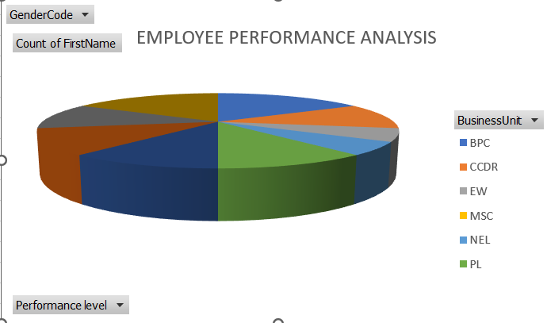
RESULT:
18

Slide 19
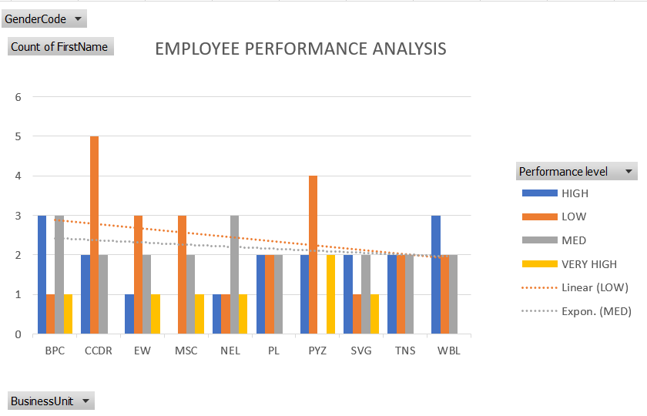
RESULT:

Slide 20
Conclusion :
Effective people management is crucial for organizational success, as employees are key assets driving company goals.
A well-knowledge highlights that while personal success for employees is about individual growth, leaders must focus on growing others.
Employee performance analysis is essential in this context, providing valuable insights that help in nurturing talent and enhancing overall productivity, ultimately leading to organizational excellence.
The Employee Engagement Survey Dataset presents a comprehensive collection of responses obtained through an organization-wide employee engagement survey.
This dataset is intended to analyze the levels of employee engagement, satisfaction, and sentiment across various facets of the workplace, facilitating insights into workforce dynamics and guiding strategies for improvement.

